Slide 1

PROJECT SUMMARY REPORT

Slide 2
OUR TEAM
Aakanksha Bagate
Pankaj Jagtap
Stebin Benny
Reetu
Khushbu Kedar

Slide 3
TIMELINE
30 Mar 24
6 Apr 24
13 Apr 24
20 Apr 24
27 Apr 24
Kick off meeting
Implementation of KPIs using Excel
Implementation of KPIs using Tableau
Implementation of KPIs using Power BI
And SQL
Final Report

Slide 4
01
EXCEL DASHBOARD

Slide 5
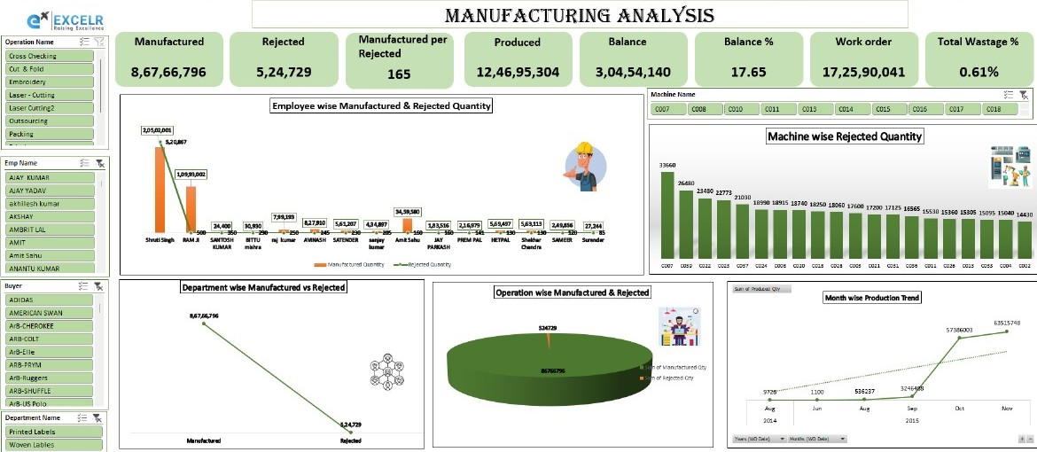

Slide 6
02
TABLEAU DASHBOARD

Slide 7
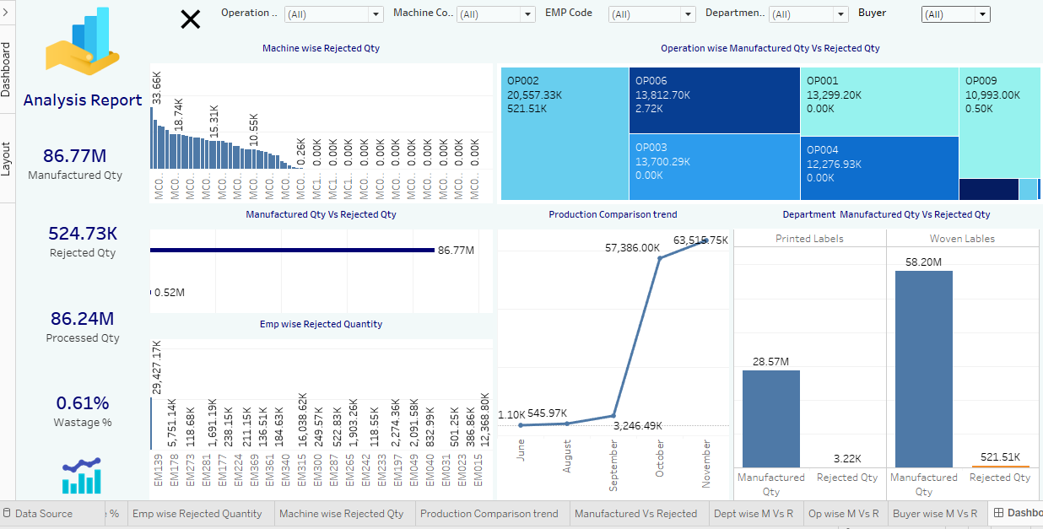

Slide 8
03
POWER BI DASHBOARD

Slide 9
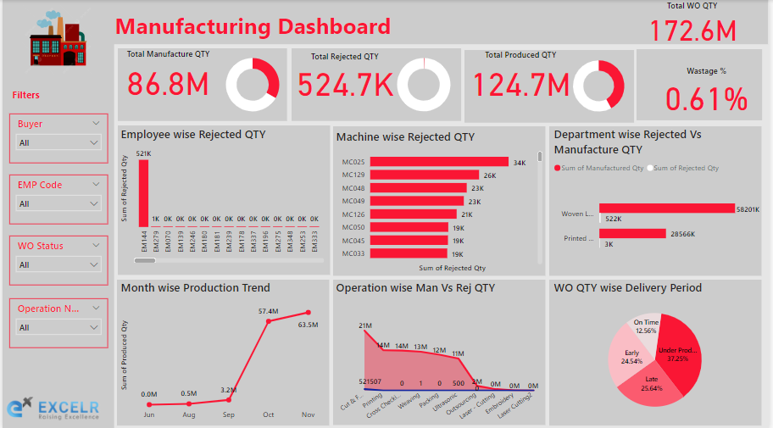

Slide 10
04
INSIGHTS

Slide 11
Total Work Order Quantity : The aggregation of all work orders amounted to a staggering 172.6 million units, reflecting the scale and magnitude of the manufacturing operations under scrutiny.
Manufactured Quantity: Out of the total work orders, 86.8 million units were successfully produced, underscoring the operational prowess and capacity utilization within the manufacturing facility
Rejected Quantity: Despite rigorous quality control measures, a total of 524.7 thousand units were rejected, signifying areas of improvement in the manufacturing process to mitigate rejections and minimize wastage.
Wastage Percentage: With a calculated wastage percentage of 0.61%, the analysis highlights the need for continuous optimization efforts to reduce wastage and enhance resource utilization efficiency.
Highest Rejected Quantity by Employee: Employee EM-144 emerged as a focal point, with a significant contribution to the rejected quantity, prompting further investigation into potential training needs or process improvements.
Machines with Highest Rejected Quantity: Machines bearing codes MC025, MC129, MC048, MC049, and MC129 exhibited notable instances of rejected units, indicating potential maintenance or calibration issues warranting attention.

Slide 12
Monthly Production Trends: The analysis of monthly production series unveiled notable spikes in production during October and November, providing valuable insights for capacity planning and resource allocation.
Operation-wise Analysis: The examination of operations revealed that the cut and fold operations not only accounted for the highest quantity of manufactured units but also recorded a notable proportion of rejected units, signalling areas for targeted process enhancements or quality control interventions.
Work Order Status Distribution: Utilizing a pie chart, the distribution of work order statuses revealed varying proportions, with a substantial portion under production and notable percentages categorized as late or early, necessitating strategic scheduling and workflow management approaches.
Department-wise Order Distribution: Analysis via a bar chart delineated departmental order distributions, with woven labels emerging as the predominant choice over printed labels, providing insights for inventory management and production planning strategies.
These insights offer a nuanced understanding of the manufacturing landscape, empowering stakeholders with actionable intelligence to drive informed decision-making and foster continuous improvement initiatives within the manufacturing ecosystem.

Slide 13
05
KEY TAKEAWAYS

Slide 14
Understanding Data
Handling blanks and errors
Knowing new chart types
Explore different data visualization techniques
Easy-to understand data analysis reports

Slide 15
THANKS!

